Slide 1


Topic 01
History of the Web
Web Foundations
PROG124
Prof. Andria Vanezi

Slide 2
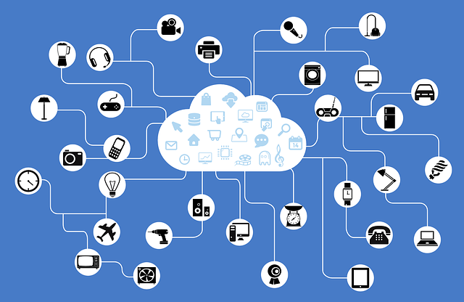
The Internet
Notes:
Image link: https://pixabay.com/vectors/network-iot-internet-of-things-782707/

Slide 3
What is the internet?
Worldwide system of computer networks
A network of networks in which users at any one computer can, if they have permission, get information from any other computer (and sometimes talk directly to users at other computers)
Public, cooperative and self-sustaining facility accessible to hundreds of millions of people worldwide

Slide 4
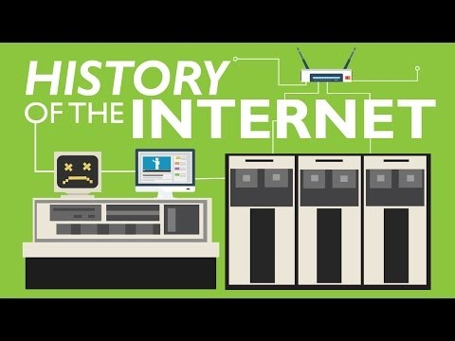
History of the Internet in 3 minutes
https://youtu.be/h8K49dD52WA

Slide 5
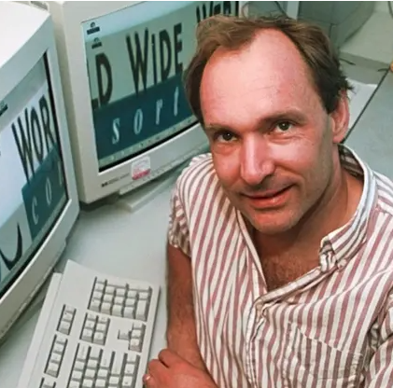
Sir Tim Berners-Lee
1969: Advanced Research Projects Agency (ARPA) U.S. government in ARPANET
1989: invented by Sir Tim Berners-Lee
  British computer scientist, European Organization for Nuclear Research (CERN)
Created the web as a way for CERN researchers to share information more easily
1990, Berners-Lee developed the first web browser, called WorldWideWeb
  to view web pages and navigate between them using hyperlinks
Created the first web server, which allowed users to access web pages remotely
Source: https://webfoundation.org/about/vision/history-of-the-web/

Slide 6
Three fundamental technologies
Sir Tim Berners-Lee had written the three fundamental technologies that remain the foundation of today’s web:
  HTML: HyperText Markup Language. The markup (formatting) language for the web.
  URI: Uniform Resource Identifier. A kind of “address” that is unique and used to identify each resource on the web. Commonly called a URL.
  HTTP: Hypertext Transfer Protocol. Allows for retrieval of linked resources from across the web.

Slide 7
History of the Web
1991: People outside of CERN were invited to join this new web community.
Realization that the true potential of the Web would only be unleashed if anyone, anywhere, could use it without paying a fee or having to ask for permission.
1993: CERN made the underlying code available on a royalty-free basis, forever.
1994: World Wide Web Consortium (W3C) was founded. It is an international community devoted to developing open web standards.
Source: https://webfoundation.org/about/vision/history-of-the-web/

Slide 8
Concepts of the Web
The early web community produced some revolutionary ideas that are spreading far beyond the technology sector today…
Decentralization: No permission is needed from a central authority to post anything on the Web, there is no central controlling node, and so no single point of failure … and no “kill switch”! This also implies freedom from indiscriminate censorship and surveillance.
Non-discrimination: If I pay to connect to the internet with a certain quality of service, and you pay to connect with that or a greater quality of service, then we can both communicate at the same level. This principle of equity is also known as Net Neutrality.
Bottom-up design: Instead of code being written and controlled by a small group of experts, it was developed in full view of everyone, encouraging maximum participation and experimentation.
Universality: For anyone to be able to publish anything on the Web, all computers involved had to speak the same language to each other, no matter what different hardware people are using, where they live, or what cultural and political beliefs they have. In this way, the Web breaks down silos while still allowing diversity to flourish.
Consensus: For universal standards to work, everyone had to agree to use them. Tim Berners-Lee and others achieved this consensus by giving everyone a say in creating the standards, through a transparent, participatory process at W3C.
Source: http://webfoundation.org/about/vision/history-of-the-web/

Slide 9
Erosion of founding concepts
Centralization: a few large companies dominating the web landscape.
  Platforms like Google, Facebook, and Amazon have significant control over the web and the data that flows through it.
  Concerns about privacy, data ownership, and the concentration of power in the hands of a few companies
Discrimination: growing concerns about bias and discrimination on online platforms.
  Algorithms and data-driven decision-making processes can perpetuate and amplify existing biases, and online harassment and hate speech can create a hostile environment for marginalized communities.
Top-down design: top-down in its design, with companies and designers making decisions about how users interact with the web
  users have more control over the content they create and share, the platforms limits user agency and choice.
Fragmentation: Variety platforms and services offering distinct experiences and interfaces can make it difficult for users to navigate the web and find the information they need
Commercialization: advertising and e-commerce becoming key drivers of the web economy
  concerns about the impact of advertising on user experience and the influence of commercial interests on the web

Slide 10
Net Neutrality
Principle that all internet traffic should be treated equally, without discrimination or preference given to certain websites, services, or users
  Ensures that all data on the internet is transmitted at the same speed, without any interference or manipulation by internet service providers (ISPs) or other intermediaries
  Based on the concept of an open internet, where users have the freedom to access any website or online service without limitations or restrictions
Without Net Neutrality
  ISPs can potentially create a "fast lane" for certain websites or services, while slowing down or blocking access to others
  tiered internet, large companies with more resources and bargaining power can pay for faster access than smaller companies and individuals are relegated to a slower and less reliable internet experience
2015 the FCC under the Obama administration passed legislation under the Open Internet Order which allowed the FCC to regulate IPSs more strictly and enforce net neutrality rules
2017, the FCC under the Trump administration repealed the Open Internet Order, effectively ending net neutrality protections in the United States
https://www.youtube.com/watch?v=fpbOEoRrHyU
https://www.youtube.com/watch?v=92vuuZt7wak

Slide 11
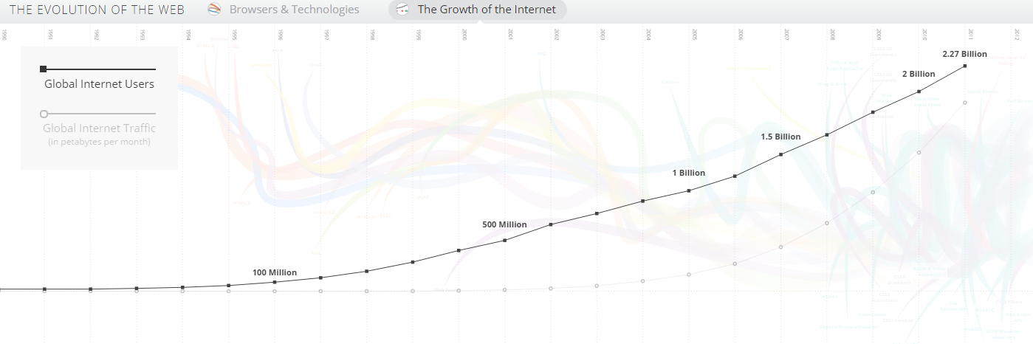
Growth of the Internet
http://evolutionofweb.appspot.com/

Slide 12
Web 2.0
Introduction of search engines like Yahoo and Google in the late 1990s made it easier to find information on the web
Emergence of e-commerce sites like Amazon and eBay made it possible to buy and sell goods online
Early 2000s, the web entered a new phase with the introduction of Web 2.0, which emphasized user-generated content and social interaction
Rise of social media platforms like Facebook and Twitter, as well as the development of web-based applications like Google Docs and Dropbox
2003: The companies developing new web standards committed to a Royalty Free Policy for their work.
2009: World Wide Web Foundation was established. Its goal is to advance the Open Web as a means to build a just and thriving society by connecting everyone, raising voices and enhancing participation.
2014: 25 years since the birth of the Web almost two in five people around the world were using it.
The web is an integral part of everyday life for billions of people around the world, with new technologies like mobile devices and cloud computing driving ongoing innovation and growth
  The right to Internet access
  Free speech
  Right to access to information

Slide 13
Web 3.0
Next generation of the internet: more intelligent, decentralized, secure and connected than the current version
Early stages of development: no consensus on exactly what it will look like or what technologies will be used to build it
General trends and ideas that are associated with the concept of Web 3.0.
  built on decentralized technologies such as blockchain: allows for peer-to-peer transactions and data sharing without the need for intermediaries
  artificial intelligence and machine learning to create more intelligent and personalized experiences for users
    personalized search results, natural language processing, and intelligent chatbots.
  more secure and private than the current version of the web.
    zero-knowledge proofs and homomorphic encryption, which allow for secure data sharing and processing without revealing sensitive information.

